Slide 1


Mantid Scientific Steering Committee
Nick Draper
03/09/2011

Slide 2
This Release
Target Date
  23rd September 2011
Huge release
  473 tickets (312 previous)
Released on time

Slide 3
Progress over the last iteration
Algorithm Dialogs
  Only valid workspaces are now available in the drop down lists of algorithms.
  A scroll bar has been added for long algorithm dialogs.
Table Workspaces
  Mantid projects can now save and load table workspaces.
    Peak workspaces do not work yet, coming soon.

Slide 4
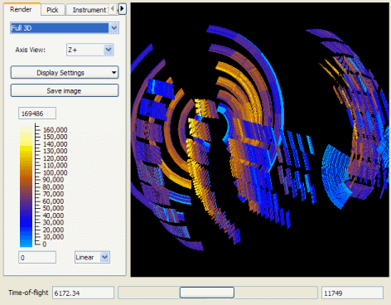
Progress over the last iteration
Instrument Display
  The colour map can be altered by clicking and dragging
  The miniplot has been resolved to better handle other units such as d-spacing.
  You can save masks to workspaces or mask files
    including or excluding the selected regions.

Slide 5
Progress over the last iteration
Plotting
  Colour map plots no longer leave large gaps when you have gaps in the spectrum numbers of your workspace.
  The default fill colour for waterfall plots is now the same as the line colour.
  The plot spectrum option on Mantid matrices is no longer offered if there is only 1 bin.

Slide 6
Progress over the last iteration
Python Scripting
  The font size in the scripting window is adjustable
    Controls in the Window menu.
  More control of the Instrument View
    E.g. it can now be opened with a particular tab selected.
  The history of a workspace can now be accessed from Python using the GeneratePythonScript algorithm.
  Python algorithms now handle errors better when a child algorithm fails.

Slide 7
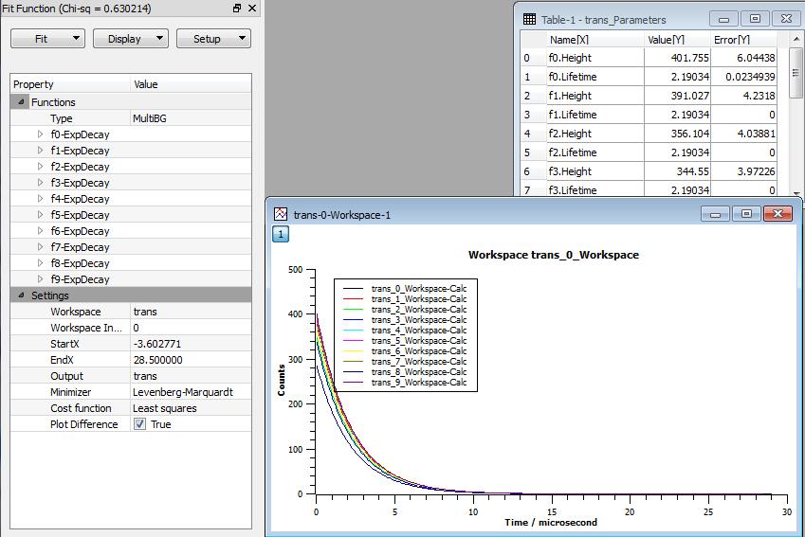
Progress over the last iteration
Model fitting and optimisation
  Sequential fitting dialog allows fitting across workspaces without needing to involve a particular log.
  A first implementation of simultaneous fitting of multiple datasets using both local and global functions has been added.
  New clear all option

Slide 8
Progress over the last iteration
Performance
  Performance tests are now run every night to highlight changes during the development cycle.
  Loading Event Prenexus and event nexus files has been significantly improved, it is now up to 4 times faster.
  The compilation speed of Mantid has been doubled on windows using precompiled headers.
  Improved memory usage and memory leaks.

Slide 9
Progress over the last iteration
SANS – ISIS
  Allow ‘metadata’ top line in cvs batch file
  Allow masking of SANS2D movable monitor 4
  Can set the range of wavelengths over which the transmission is calculated
  Change the Q/RCUT unit from meter to mm
  Allow masking between two phi angles
  Reduce the memory usage during reduction in batch mode
  Log entries used are now the first entry before experiment started

Slide 10
Progress over the last iteration
SANS - SNS/HFIR
  EQSANS reduction code works entirely with events
    Allowing quick I(Q) rebinning without the need to reprocess the data.
  Mask regions of the detector by mouse selection.
    Now integrated with the SANS reduction UI.
  The Q resolution is now computed for both reactor SANS and TOF SANS. It is written to the output I(Q) file.
  Each EQSANS frame is separately reduced and written to file.
  Added absolute scaling of reduced SANS data.
  Several UI improvements to the SANS reduction UI.
  Added convenience features to allow scripting of batch SANS reduction

Slide 11
Progress over the last iteration
Crystallography
  Diffraction algorithms
    Moved to specialized workspaces for reducing powder diffraction data.
    Save processed NeXus files as an additional file for powder diffraction data.
    Proof of concept for generating uncorrected PDFs from NOMAD.
  Single Crystal
    First implementation of TOPAZ single crystal Bragg diffraction reduction

Slide 12
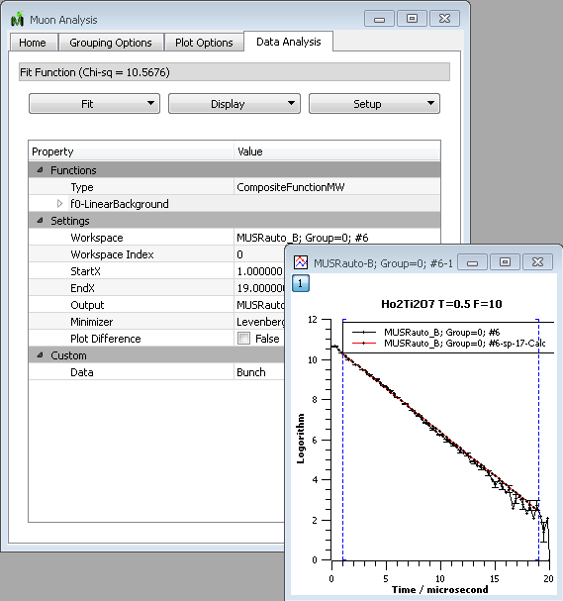
Progress over the last iteration
Muon
  Analysis fitting tab
  Next and previous buttons
  Improvements to PlotAsymetryByLogValue
  MantidPlot can now save/load TableWorkspaces generated from fitting

Slide 13
Progress over the last iteration
Instrument Definitions
  New or updated instrument definitions for Hyspec, Vesuvio, Pearl, CNCS, GP-SANS and BIO-SANS
  Updated parameter or mapping files for Vesuvio, HRPD, ALF and SXD
New/ Improved Algorithms
  28 new algorithms or significant improvements
Crashes/Bugs
  30 Notable bugs corrected

Slide 14
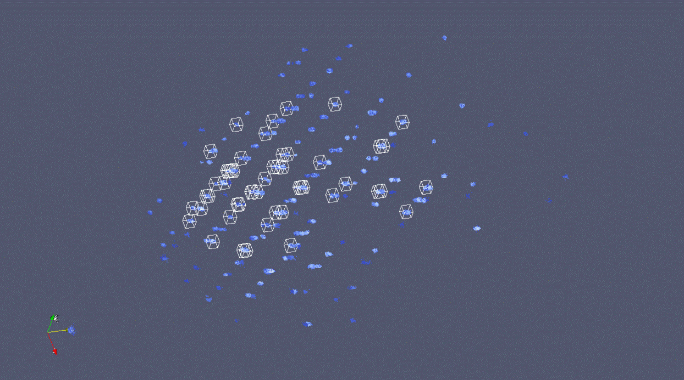
VATES
Peaks
  Peak Finding
  UB Matrix Finding
File handling
  Various formats
    Sqw, Mantid Nexus,
    event nexus
Workspace Manipulation
  Merging of multiple MDWorkspaces

Slide 15
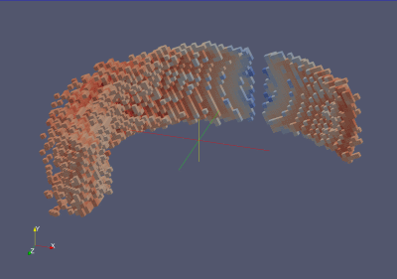
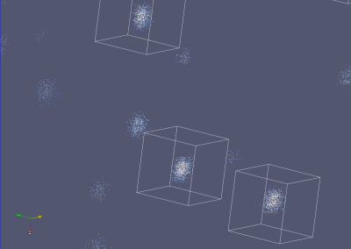
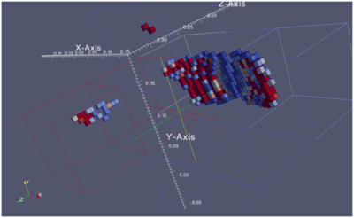
VATES
Display
  Fast visualisation of data
  Reading of Peak workspaces
    box glyphs
  Scatter plot for viewing events
  Intelligent file handling
  Access to Mantid’s in-memory data service.
Rebinning
  Common Rebinning Filters for all data except .peaks.
  Axis-aligned or with rotation
  Thesholding mechanisms

Slide 16
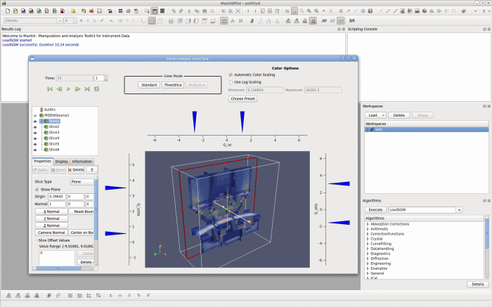
VATES
Visualisation Applications
  VATES in Paraview
  VATES in MantidPlot
    Right-click a MDworkspace
    A less complicated interface
    Supports:
      Axis aligned Rebinning
      Orthogonal three slice view
      Multi slice view

Slide 17
Next Release
Target Date
  18th November 2011

Slide 18
Mantid v2 is coming
The aim of ISIS is to be:
  The agreed version that scientists will sign off on for giving out to visitors.
What we need is:
  The list of Items / grumbles that would prevent this with the current version.
When
  By the 17th of October
What should the SNS Goal be?
  Discuss

